Slide 1

Automatic Brain Tumour Detection and Classification from MRI Images Using Deep Learning with VGG16, ResNet50
Team : 06
MLA0405 – Deep Learning
Guided by: Student Names:
Dr. A. M. Arul Raj D. N. Shirshika (192425396)
Professor N. Sai Mounika (192425367)
Institute of SIMATS Engineering Institute of SIMATS Engineering

Slide 2
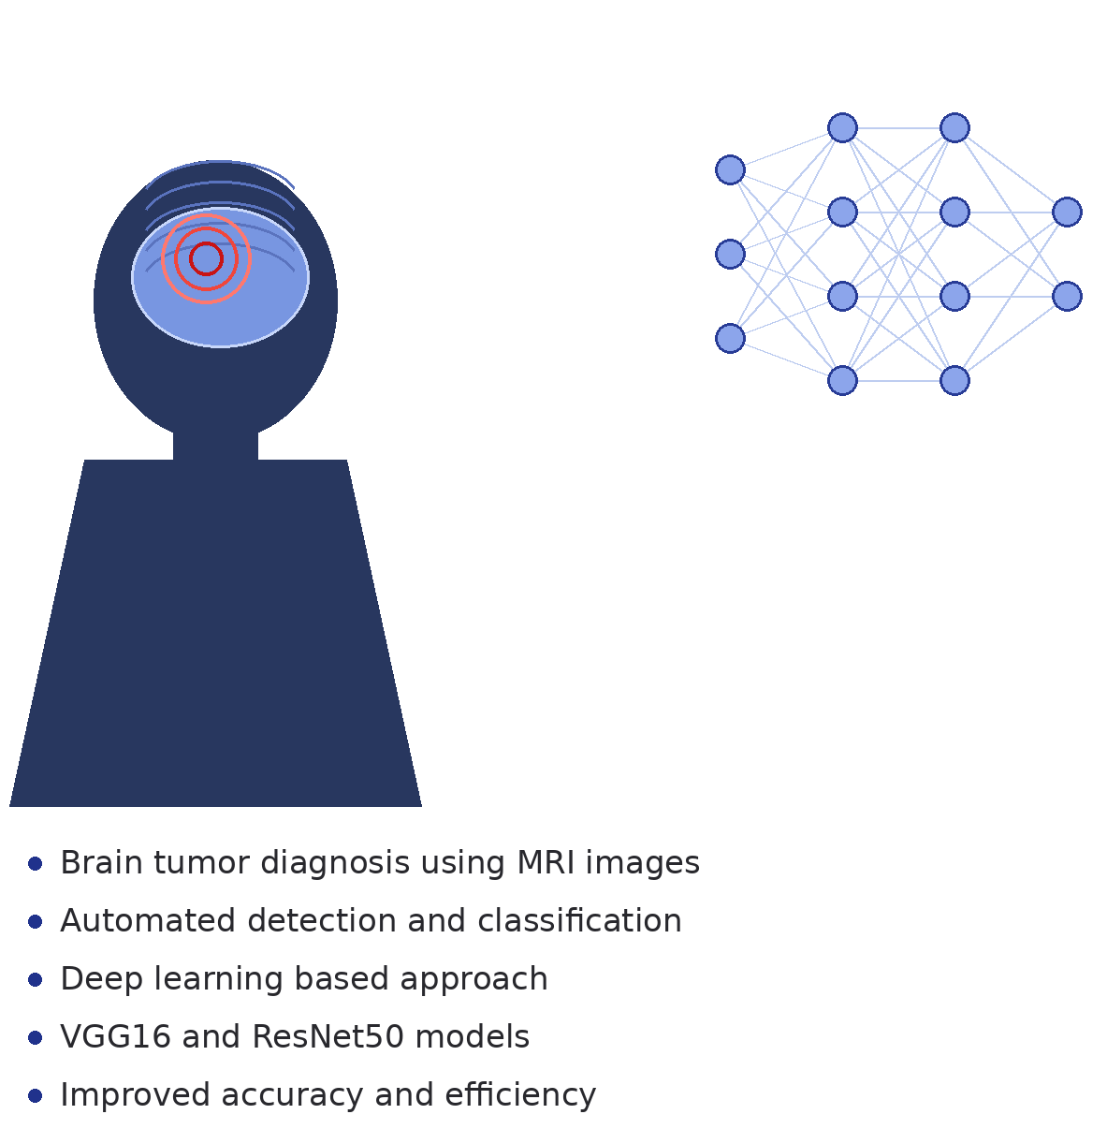
Abstract
Brain tumour diagnosis from MRI images
Manual analysis time-consuming
Deep learning-based automated detection
MRI image preprocessing
Tumor detection and segmentation
VGG16 and ResNet50 feature extraction
Brain tumor classification
Improved diagnostic accuracy

Slide 3
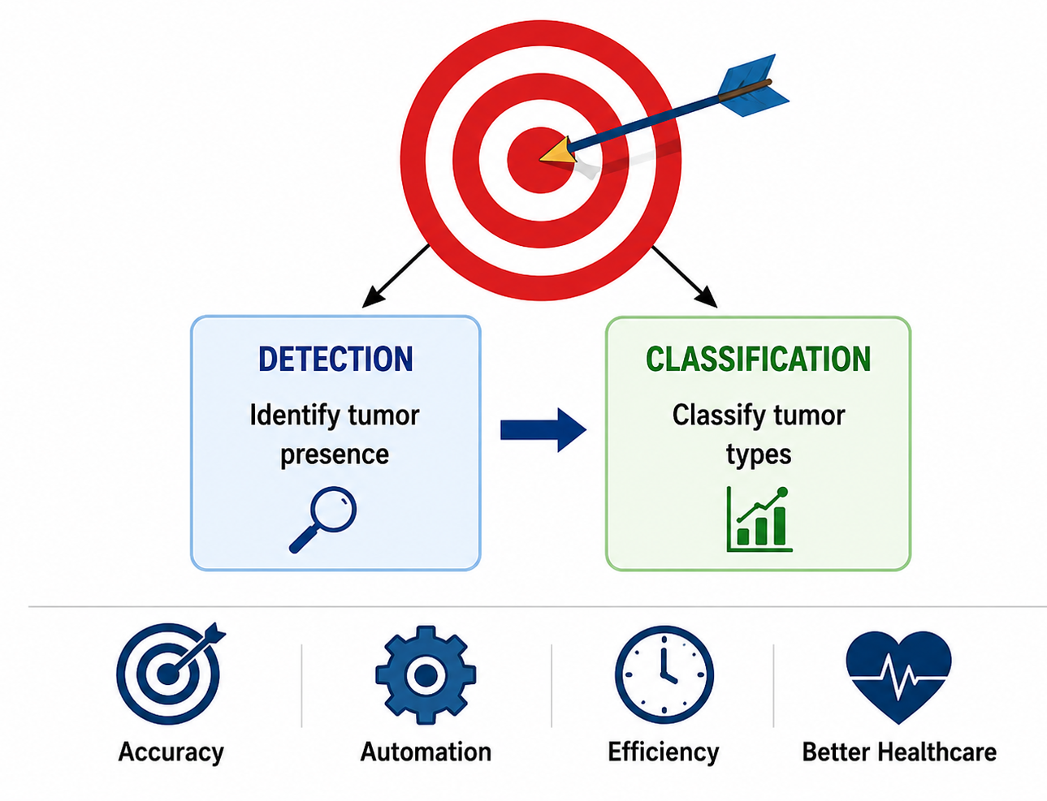
Aim & Objectives
Aim
Automatic brain tumor detection
Accurate tumor classification
Deep learning-based diagnosis
Reduced diagnostic time
Objectives
MRI image preprocessing
Tumor region detection
Feature extraction using VGG16
Feature extraction using ResNet50
Tumor classification
Performance evaluation

Slide 4
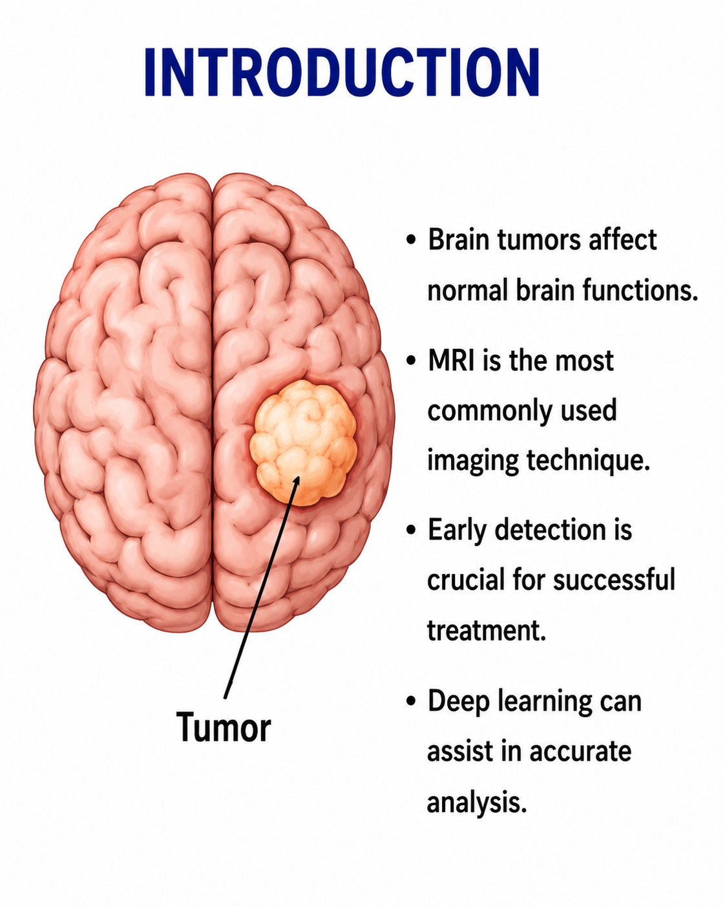
Introduction
Brain tumours affect neurological functions
MRI widely used for diagnosis
Manual diagnosis prone to errors
Deep learning improves accuracy
Automated healthcare support system

Slide 5
S.No | Year of Publication | Author | Title of the Journal / Book | Methodology Used | Algorithm Used | Key Findings
1 | 2021 | S. Deepak & P.M. Ameer | Brain Tumour Classification Using Deep CNN | MRI Image Analysis | CNN | Achieved high accuracy in brain tumor classification
2 | 2022 | A. Kumar et al. | Automated Brain Tumour Detection Using Deep Learning | Image Preprocessing & Classification | VGG16 | Improved feature extraction and detection performance
3 | 2022 | M. Sharma et al. | MRI-Based Brain Tumour Detection Using Transfer Learning | Transfer Learning | ResNet50 | Reduced training time with better classification accuracy
4 | 2023 | R. Gupta et al. | Deep Learning Approaches for Brain Tumour Analysis | Feature Extraction & Classification | CNN + ResNet50 | Enhanced tumor identification from MRI images
5 | 2024 | P. Singh et al. | Automated Brain Tumor Detection and Classification | MRI Segmentation & Classification | VGG16 + ResNet50 | Achieved robust multi-class tumor classification

Slide 6
Problem Statement
Brain tumours pose serious health risks and require early diagnosis.
Manual MRI image analysis is time-consuming and dependent on radiologists' expertise.
Traditional methods may produce inconsistent and less accurate results.
Large volumes of MRI scans make manual examination difficult.
An automated deep learning system is needed for accurate tumour detection and classification.

Slide 7
Existing System
Manual inspection of MRI scans by medical experts.
Conventional image processing and machine learning techniques.
Requires significant human intervention.
Lower accuracy for complex tumour patterns.
Longer diagnosis and treatment planning time.

Slide 8
Proposed System
Automated MRI image analysis using deep learning.
Image preprocessing and tumour region detection.
Feature extraction using VGG16 and ResNet50.
Classification of tumour types (Glioma, Meningioma, Pituitary, No Tumour).
Faster, more accurate, and reliable diagnosis support system.

Slide 9
Proposed Methodology and Algorithm
MRI Brain Image Dataset Collection
Image Preprocessing (Resize, Normalize, Noise Removal)
Tumour Detection and Segmentation
Feature Extraction using VGG16 and ResNet50
Brain Tumour Classification and Performance Evaluation
Algorithms Used
VGG16
Pre-trained CNN model
16-layer deep architecture
Feature extraction from MRI images
Transfer learning technique
High classification accuracy
ResNet50
50-layer deep neural network
Residual (skip) connections
Prevents vanishing gradients
Extracts complex features
Improves classification performance

Slide 10
Design & Module Planning
Module 1: MRI Image Acquisition
MRI Dataset Collection
Data Labelling
Dataset Organization
Train/Test Split
Data Validation
Module 2: Image Preprocessing
Image Resizing
Noise Removal
Normalization
Contrast Enhancement
Image Augmentation

Slide 11
Module 3: Tumour Detection & Segmentation
Brain Region Extraction
Tumour Localization
Tumour Segmentation
ROI Identification
Tumour Detection
Module 4: Feature Extraction
VGG16 Model
ResNet50 Model
Deep Feature Learning
Feature Optimization
Transfer Learning
Module 5: Classification & Evaluation
Tumour Classification
Prediction Generation
Accuracy Calculation
Performance Analysis
Result Visualization

